Slide 1
Voice-Enabled Observability for AI Latency
Niraj – Senior Software Engineer & Product Builder
OpsVoice Assistant
Notes:
---
Welcome to the OpsVoice investor pitch. This presentation unveils how OpsVoice solves the critical challenge of latency transparency in AI-powered applications, offering a voice-activated observability assistant for real-time insights.

Slide 2
Problem
- AI backends suffer from hidden latency blind spots
- Traditional monitoring tools miss AI-layer delays
- Slow responses → poor user retention & lost revenue
Notes:
We will cover the problem of latency in AI applications, introduce the OpsVoice solution, explain the technical workflow, showcase real-world effectiveness, review the tech stack, explore market opportunity, discuss the business model, introduce the team, and conclude with a call to action.

Slide 3
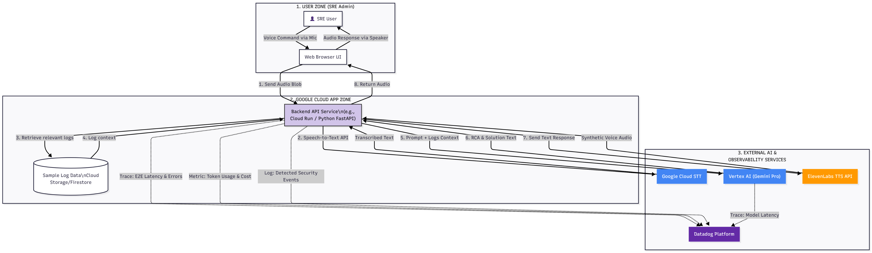
Solution
Cloud Run deployment for scalable, serverless infra
Flask backend with Datadog tracing & logging
Vertex AI Gemini integration for real LLM analysis
Voice-enabled queries for real-time observability
Notes:
As large language models become widely adopted, observability challenges emerge. Site reliability engineers struggle to determine whether latency stems from network issues or the AI model itself. High latency negatively impacts user retention and causes revenue loss.

Slide 4
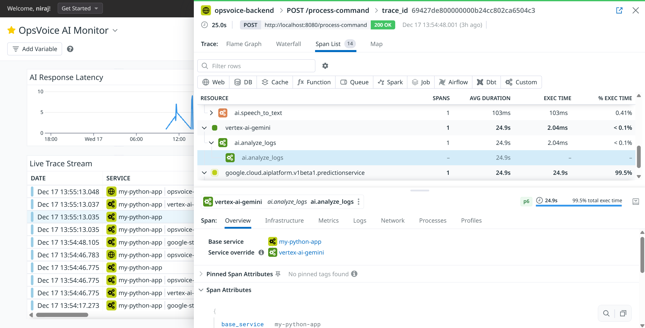
Demo Value
Detected a 33-second latency anomaly in Gemini inference
Pinpointed root cause at AI layer vs network layer
Dashboards show latency, error rates, resolution time
Judge-friendly, reproducible demo assets
Notes:
---
The rapid rise of large language models (LLMs) introduces complex latency sources that traditional monitoring tools cannot fully capture, leading to blind spots in performance diagnostics.
Image source: Microsoft 365 content library

Slide 5
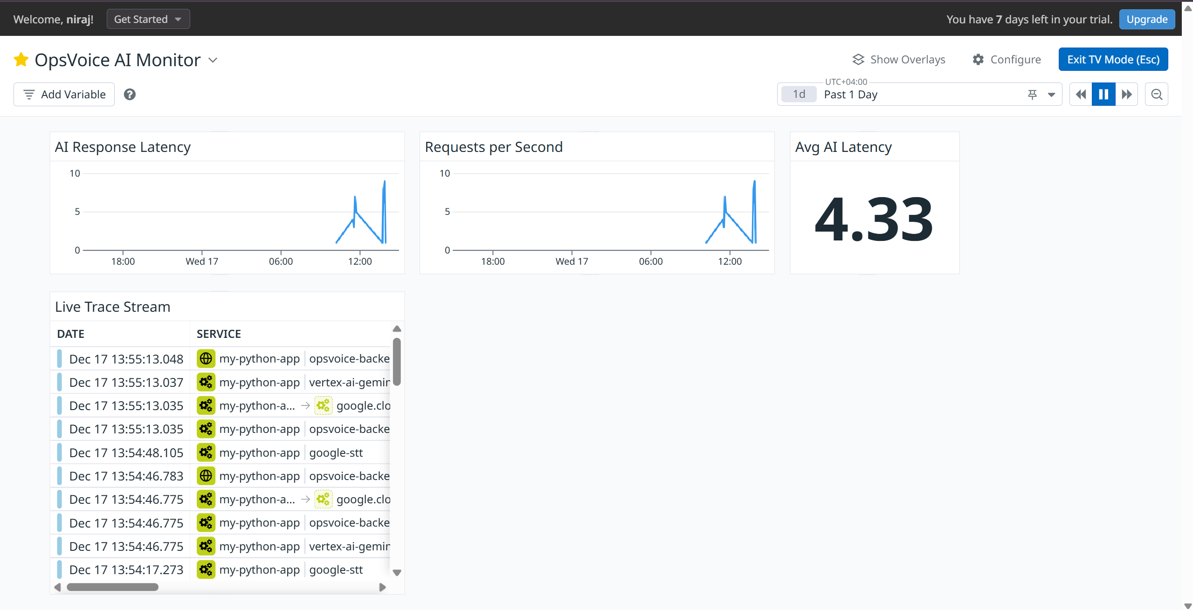
Market Opportunity
- AI observability market: $20B+ by 2028
- Enterprises adopting LLMs at 40% CAGR
- OpsVoice bridges the critical AI-layer visibility gap
Notes:
---
Site reliability engineers often face difficulties pinpointing whether delays are due to network congestion or AI model processing, which slows incident response and resolution.
Image source: Microsoft 365 content library

Slide 6
Business Model
- SaaS subscription for enterprise SRE teams
- Usage-based pricing tied to tokens per second
- Future: cost-per-query analytics for budget control
Notes:
---
Delays in AI response times degrade user experience, causing frustration that leads to diminished retention rates and ultimately impacts revenue streams negatively.
Image source: Microsoft 365 content library

Slide 7
Competitive Edge
Competitors: Datadog, New Relic, Elastic
Differentiator: AI-native observability + voice interface
Faster setup, hackathon-proven, reproducible dashboards
Notes:
OpsVoice leverages a natural voice interface for real-time queries, visualizes AI versus application layer performance, and precisely identifies latency sources to accelerate incident response.

Slide 8

Team
- Niraj – Backend & Observability Expert (Python, Flask, Datadog, Cloud Run)
- Hackathon-proven delivery mindset
- Future hires: Sales, DevRel, Product
Notes:
---
Users can interact with OpsVoice via voice commands, enabling hands-free, immediate access to observability data and faster troubleshooting.
Image source: Microsoft 365 content library

Slide 9
Ask
- Seeking $500K seed funding
- Funds for infra scaling, GTM, and enterprise pilots
- Goal: onboard 10 enterprise customers in 18 months
Notes:
---
OpsVoice provides clear visual distinctions between AI model latency and application layer delays, empowering teams with actionable insights.
Image source: Microsoft 365 content library

Slide 10
Vision
“Stop guessing. Start observing AI performance in real time.”
Contact: niky.sway@gmail.com
Notes:
---
By identifying exact bottlenecks quickly, OpsVoice reduces mean time to resolution and minimizes downtime impacts.
Image source: Microsoft 365 content library

